Slide 1

Where 2 Move
Ricardo Garcia-Rosas

Slide 2

Introduction
You are moving to a new city on the other side of the world, what suburb should you move to?
What do you care about?
Venues nearby
Rent price

Slide 3
Data – Venues
What venues are in the suburb?
Data Needed:
Suburb geographical location
Radius of interest

Slide 4
Data – Rent Price
What is the rent price in a suburb?
Data Needed:
Median rent price for all suburbs
Suburb median rent price percentile

Slide 5
Methodology
Generate features
1
Venue frequency
Rent price percentile
Generate target city model
2
Feature intersection
Estimate using source suburb data
3

Slide 6
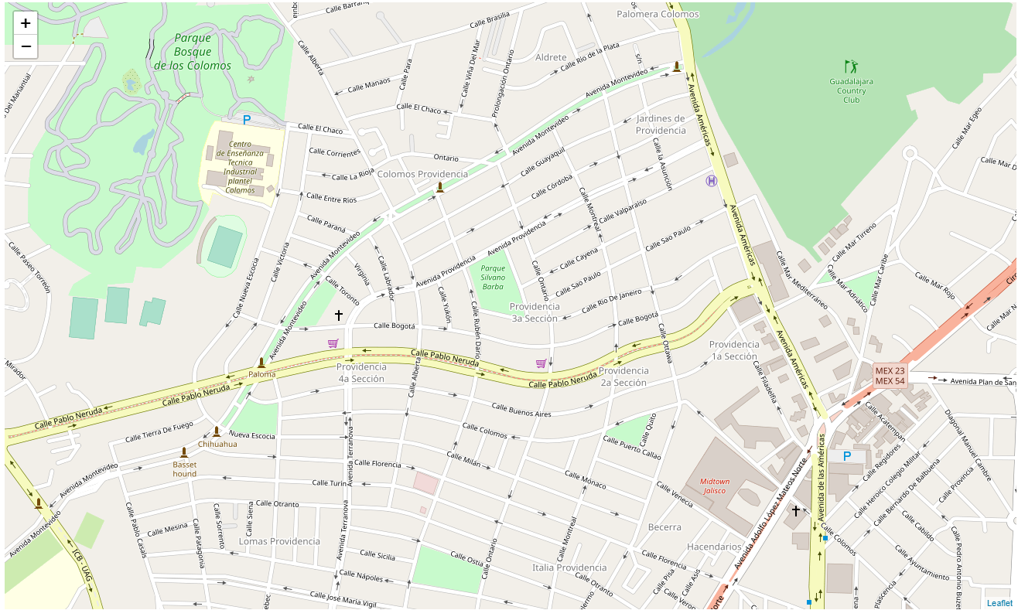
Source Suburb Data
The geographical coordinates of PROVIDENCIA are 20.6973972, -103.3786781

Slide 7
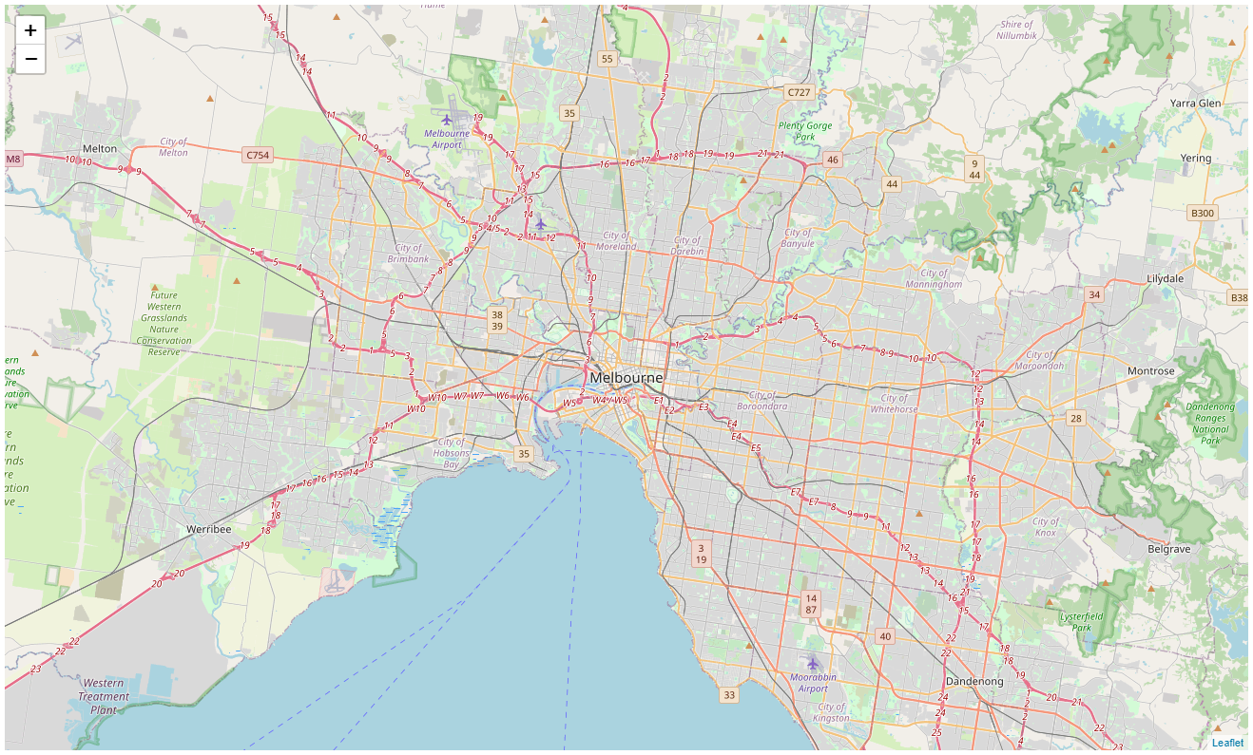
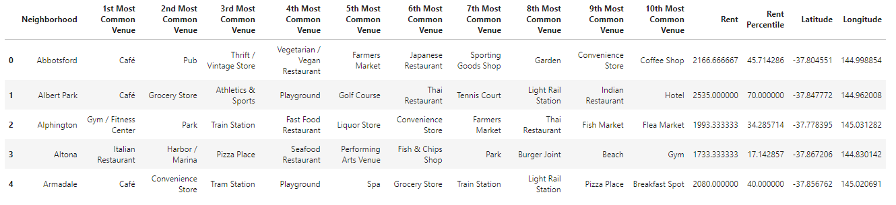
Target City Data
The geograpical coordinates of MELBOURNE are -37.8142176, 144.9631608

Slide 8
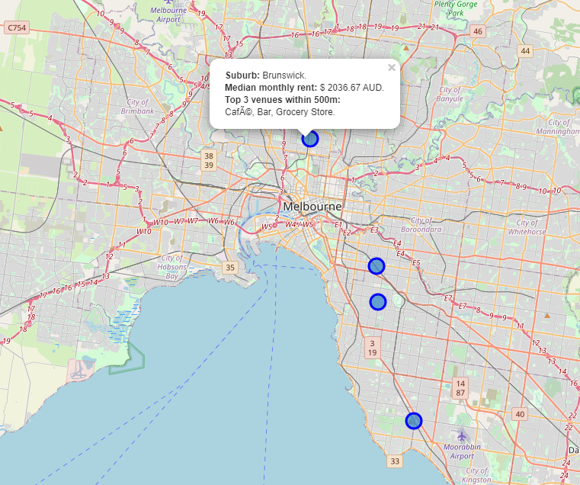
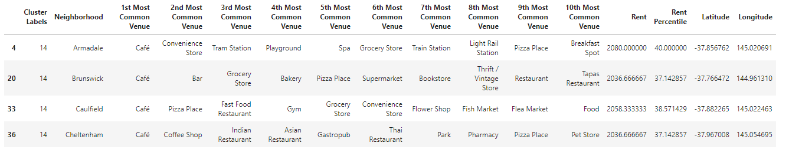
Results

